Slide 1

NCR 4109
BID 141KM SF300065C002.1X - Zeta wires unlocking

Slide 2
Pipe section / details
Item | Traceability / identification
Project number | 300065C002
Project name | BID 141KM
Pipe section | SF300065C002.1X
ST number | ST101.51896
Affected layer / equipment | Zeta Wire Spiralling
Length affected | 5458.9m
Drawing number / MP code / STA / Dimension | Raw Materials : ZETA 6.2 F109 (MP205)

Slide 3
Overview of anomaly
Problem Description:-
During the zeta spiraling of BID 141KM SF300065C002.1X (ST101.51896), the zeta unlock was detected at length 5458.9m
Root Cause:-
The root cause was due to uneven brake adjustment.
Problem Handling:-
Reparation by un-spiral has been performed to re-position the wires to be in a good spiral. Thus, this reparation was accepted as it is and the dimensional after the repair is within the criteria.

Slide 4
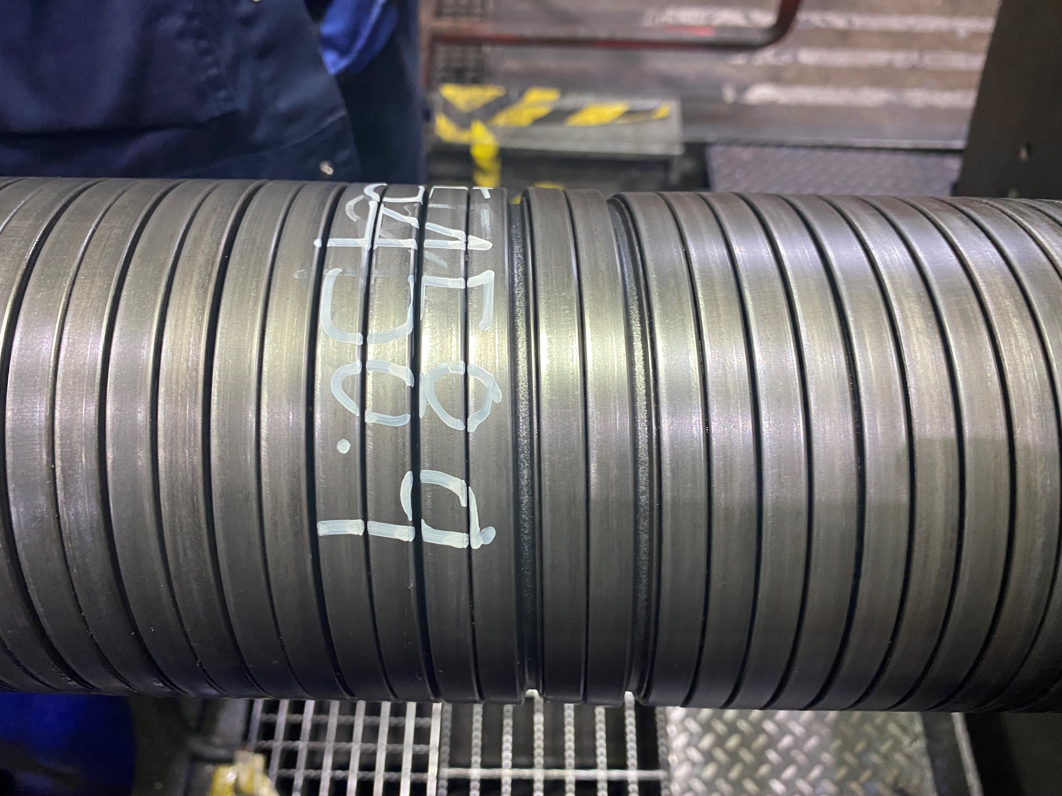
Zeta wire unlock
Figure 1 : zeta unlock was detected at length 5458.9m

Slide 5
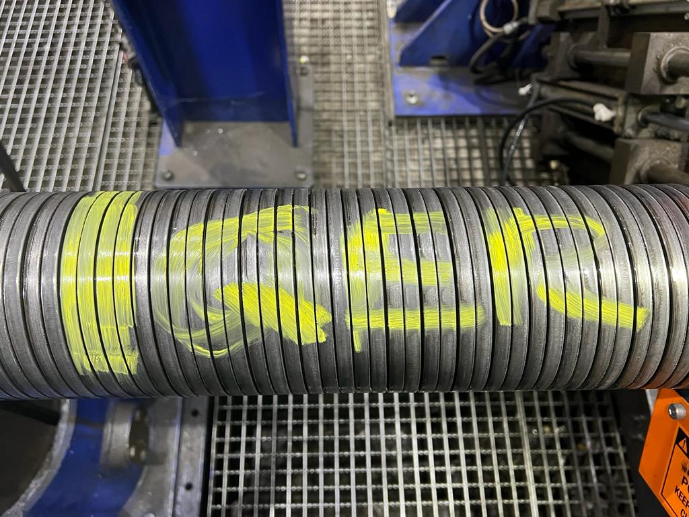
After repair
Figure 1 : condition after unspiral and re-spiral

Slide 6

THANK YOU

